Slide 1
LED Design
Arduino Team
FRC226

Slide 2
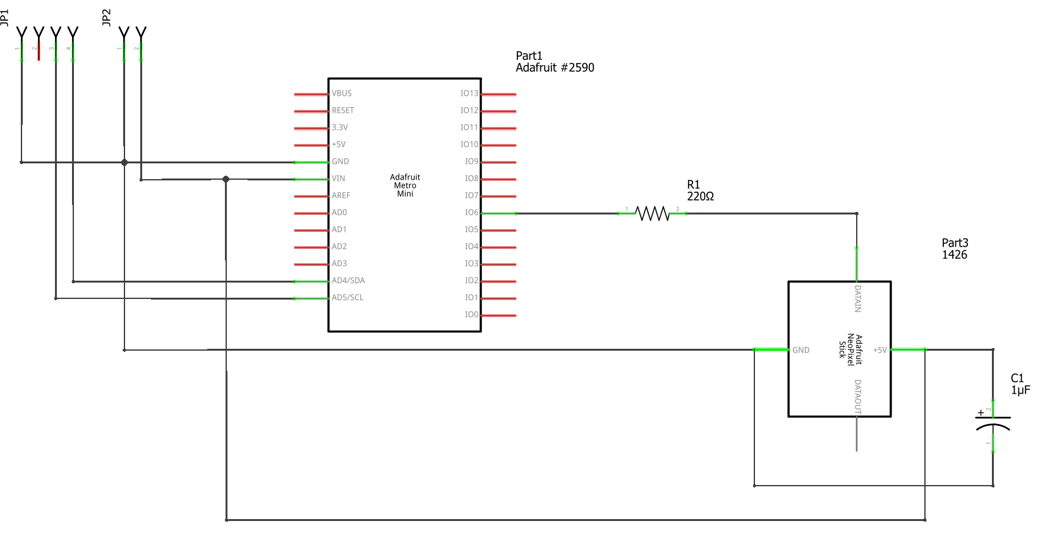
LED Module Design (Schematic)
I2C
Power
GND
SDA
GND
SCL
VIN

Slide 3
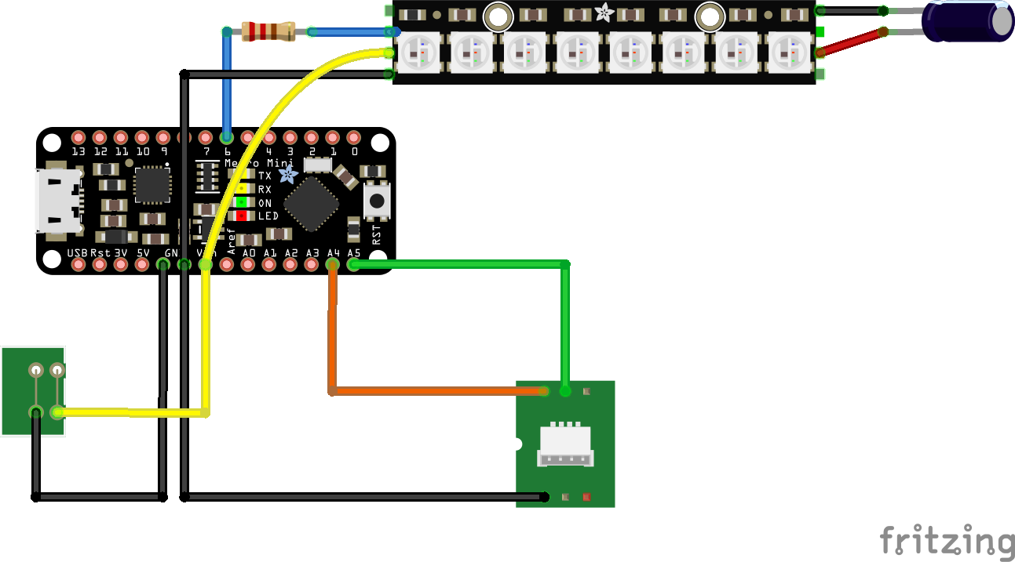
LED Module Design (Wiring Diagram)
Resistor (220 Omh)
Capacitor
Metro Mini
SCL
SDA
Power (Battery)
VIN(12V)
I2C connector
GND
GND

Slide 4
Programming on LED module
Install the NeoPixel and Arduino thread libraries
Load the NeoPixels_device.ino to the LED module
Revise the constant as needed (#pixels, device id)
#define NUMPIXELS 8
#define I2C_DEVICE_ID 8
Use the Arduino UNO as the master for testing (code i2c_mater.ino attached)
Arduino
UNO
GND
SCL (A5)
SDA (A4)
GND
SCL
SDA
master
LED#1
5V
GND
slave

Slide 5
LED I2C interface programming
Control code
Name | data length #bytes | command
 |  | byte 0 | byte 1 | byte 2 | byte 3 | byte 4 | byte 5 | byte 6
Color gradient mode | 5 | 0 | addr | count | mode | Step interval
Set color to a specific pixel | 5 | 1 | addr | red | green | blue
Activate the pixels | 1 | 2
Enable serial line (rs232) debug console | 1 | 3
Disable serial line (rs232) debug console | 1 | 4
Reset, black out all pixels | 1 | 5
Set color to all pixels | 4 | 6 | red | green | blue
Set color to a subset of pixels | 6 | 7 | addr | count | red | green | blue
Show blinking pattern for a subset of pixels | 7 | 8 | addr | count | red | green | blue | cycle interval
Show shifting pattern for a subset of pixels | 6 | 9 | count | red | green | blue | step interval
 | Parameter Name | Meaning
 | addr | pixel address (0, #NUMPIXEL)
 | count | number of pixels
 | mode | 0 - red, 1 - green, 2 - blue, 3 - RG, 4 - GB, 5 - RB, 6 - RGB, 7 - R<->B, 8 - G<->B, 9 - R<->B
 | red | (0-255)
 | green | (0-255)
 | blue | (0-255)
 | step interval | unit: milliseconds
 | cycle interval | Unit: 0.1 second
Start
Write control code to LED module via master-to-slave write function
Read 1-byte (LED status) via master-to-slave read function
LED status busy?
Yes
No
Status code
End
data length # bytes | byte 0
1 | status: 0 - idle, 1 - busy

Slide 6
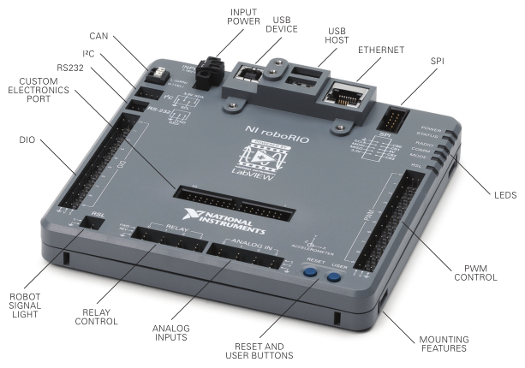
Integration on Robot
I2C connector
https://forums.ni.com/t5/FIRST-Robotics-Competition/roboRIO-Details-and-Specifications/ta-p/3494658
FRC Controller
GND
SCL
SDA
master
GND
SCL
SDA
GND
SCL
SDA
GND
SCL
SDA
LED#1
LED#2
…
LED#N
5V
GND
slave

Slide 7
Tasks to be completed
Task | Leader | Date
Lab coordination (picking up the ordered parts, soldering station preparation, etc.) | Kristian | 2/14
Building LED modules | Aarti | 2/14
Flashing the software (NeoPixels_device.ino) to the LED modules | Sachin | 2/14
Installing LED modules to the FRC robot | Archana | 2/14
Programming on FRC robot (Java) | Christine Zeng & Shriya Shah | 2/14
Testing the LED system on FRC robot | Christine Zeng & Shriya Shah | 2/14

